Slide 1
Cohort Overview
Mia M. Gaudet, Ph.D.
Connect Chief Scientist
Trans Divisional Research Program
Division of Cancer Epidemiology and Genetics
National Cancer Institute

Slide 2
Study Objectives
Comprehensive research resource using new technologies and methods for the scientific community to study:
Cancer Etiology
Precursor to Tumor Progression
Cancer Risk Prediction
Early Detection of Cancer
Survivorship

Slide 3
Connect Designed to Address Key Research Priorities
Emerging exposures
Novel biomarkers, genomics
Diverse and special populations
Cutting-edge methodology
Notes:
Connect will address key research priorities in epidemiological research.
The priorities include identification of emerging exposures and further elucidation of previously known risk factors associated with cancer risk through use of novel biomarkers and cutting-edge methodology.
Exposure, biomarker and genomic data will advance risk prediction efforts.
The resource will also include biospecimens and images for studies of natural history of cancer, tumor heterogeneity, and early markers of detection.
Diverse populations reflecting the racial and ethnic distribution of the US population

Slide 4
Cohort Study Design Overview

Slide 5
Key Features of Connect as a Trans-NCI Resource
Serial Questionnaires
200,000 adults across the US
Aged 40-65 years
No history of cancer
Patients or members of partner health care systems
Long-term follow-up
Serial assessments
Comprehensive cancer outcomes
Flexible infrastructure for enhancement studies
Tumor Registries
Serial
Biospecimens
Integrated Health Care Systems
Tissue specimens
Electronic Health Records Imaging
Mobile and wearable technologies

Slide 6
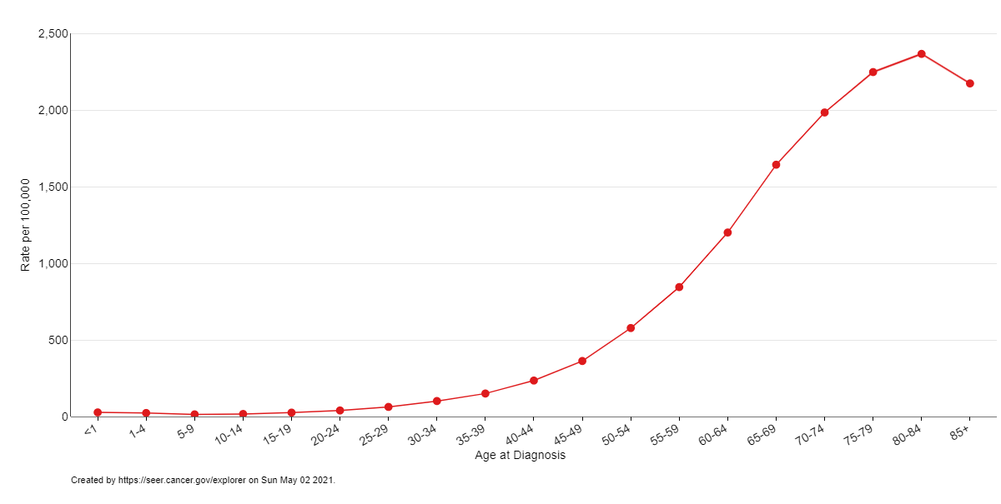
Serial Assessments to Observe Longitudinal Changes
Age-Specific SEER Incidence Rates, 2014-2018
All races, sexes
Incidence rate, per 100,000
Biospecimens
Exposures
Pre-clinical cancers
Survey & EMR
Age at diagnosis, years
Notes:
Serial survey, EMR pushes, and biospecimen collections - to observe longitudinal changes over time and capture windows when most people are at highest risk of cancer.

Slide 7
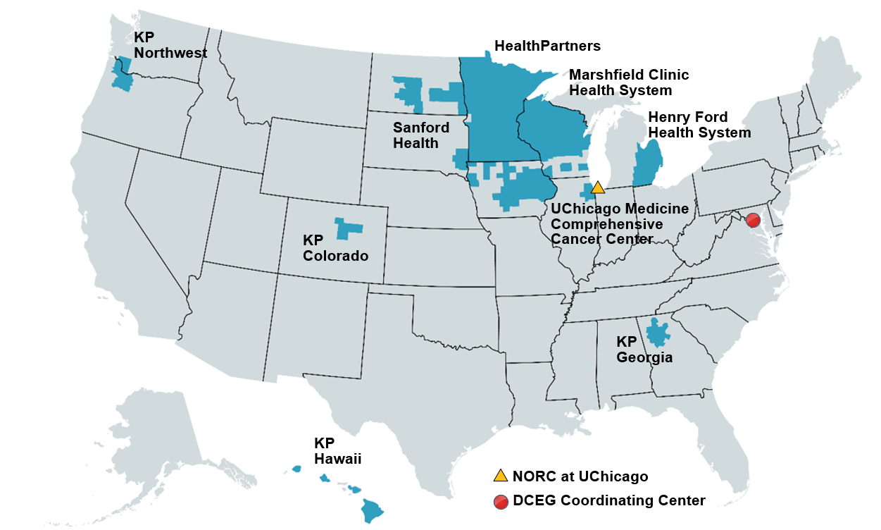
Recruitment at Partner Health Care Systems
Notes:
Sites were identified from an open contract call for proposals from eligible health care systems. All were awarded.
We are currently planning to recruit from nine health care systems
Hoping to recruit 10% of the base population.

Slide 8
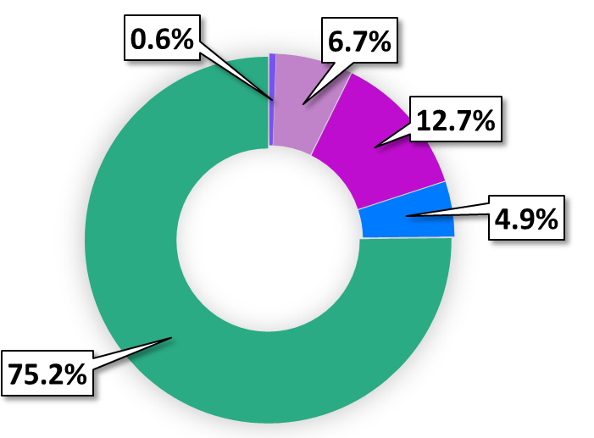
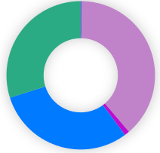
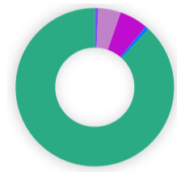
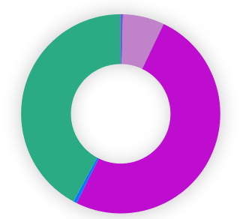
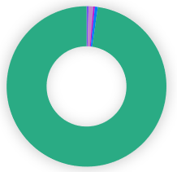
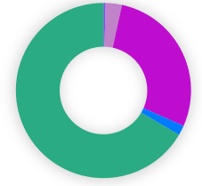
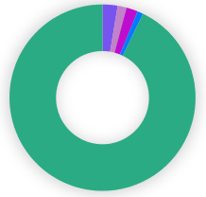
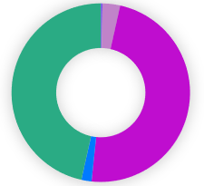
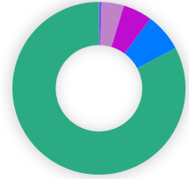
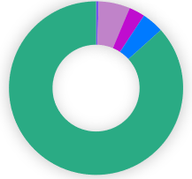

Diversity of Catchment Population: Race and Ethnicity (Based on 2018 estimates)
Individual Recruitment Sites
All Sites
Among all races, 6.1% Hispanic
Kaiser
Hawaii
Health Partners
(Minnesota)
Kaiser
Georgia
Marshfield
(Wisconsin)
Henry Ford
(Detroit)
Sanford
(Dakotas)
University of Chicago
Kaiser
Colorado
Kaiser Northwest
(Portland, OR)
American Indian, Alaskan Native
Asian
Black
Other
White
Notes:
Aligns with US Census 2018

Slide 9
Participant Engagement

Slide 10

Recruitment Materials & Strategy
Value proposition to anchor communications
Prevention-focused messaging
Materials designed to engender trust, enthusiasm, and inclusivity
Monetary and non-monetary incentives
Active and passive recruitment
Notes:
The value proposition is displayed on our Connect homepage. This public website is designed to engender trust and enthusiasm for the study; to entice potential participants to learn more.
The value proposition is the anchor of all of our communications with participants and conveys the intended value of participation. It was created in partnership with the Office of Communications and Public Liaison. It has gone through a number of iterations, and we’ve received input on various ideas from stakeholders including our participant advisory board members. We are following best practices and designing communications and marketing materials that are fully in line with all federal requirements and NCI branding.

Slide 11

Retention Strategies
Candid messaging about participant burden for the long-term
Responsive communication using multiple channels
Incentives for retention, such as return of results

Slide 12

Ongoing Engagement Strategies
Digital engagement
Regular contact every 6 months beyond those for study activities
“Study anniversary” mailing
Monitor real-time metrics to pivot engagement strategy

Slide 13
MyConnect Participant App

Slide 14
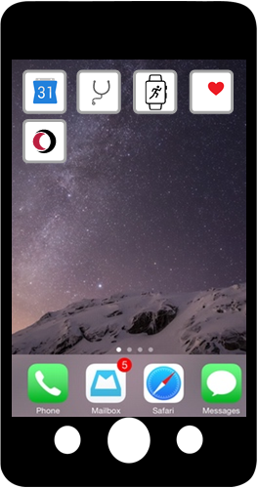







MyConnect Participant App: Communication and Study Activity Hub
Reminders & Communication
Healthcare Provider App
Health App
Mobile/ Wearable Technologies
Notes:
There has been a lot of progress in this area since the last update.

Slide 15
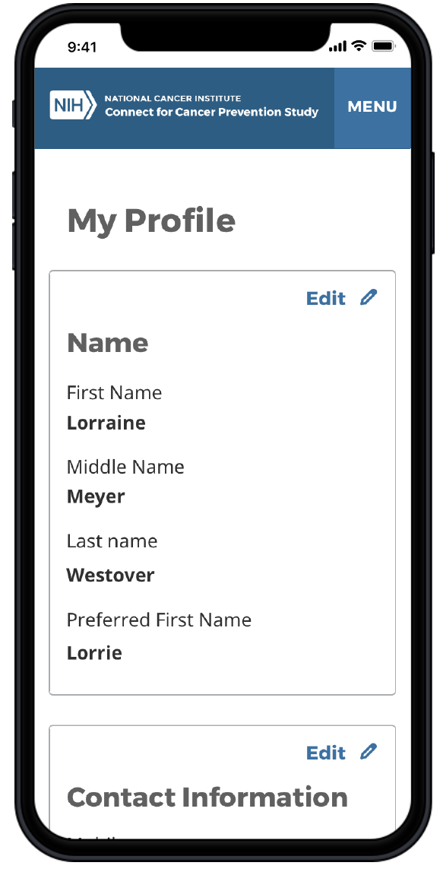
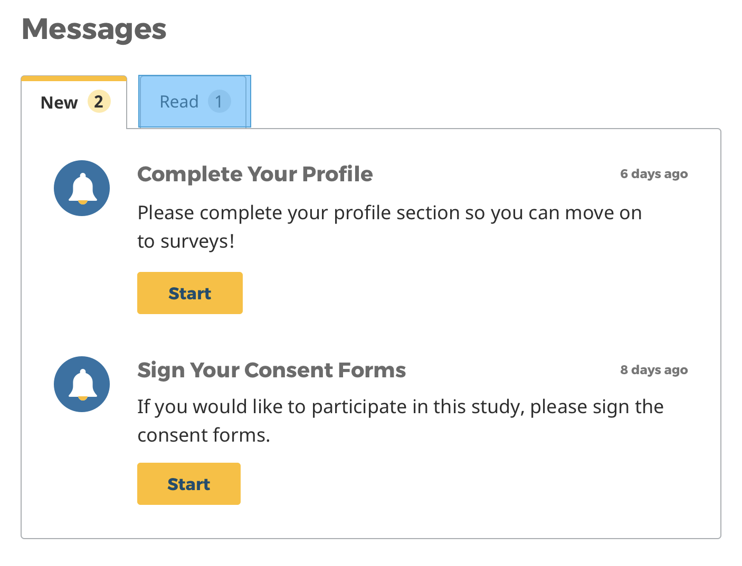
Messages and Data Input
Notes:
MyConnect is also where participants will eceive study related messages and provide their data.

Slide 16
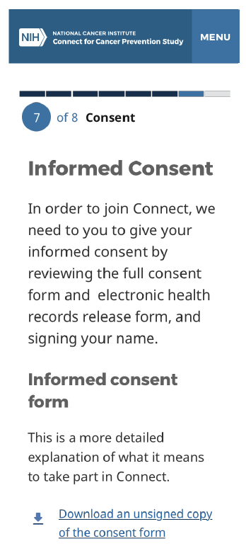
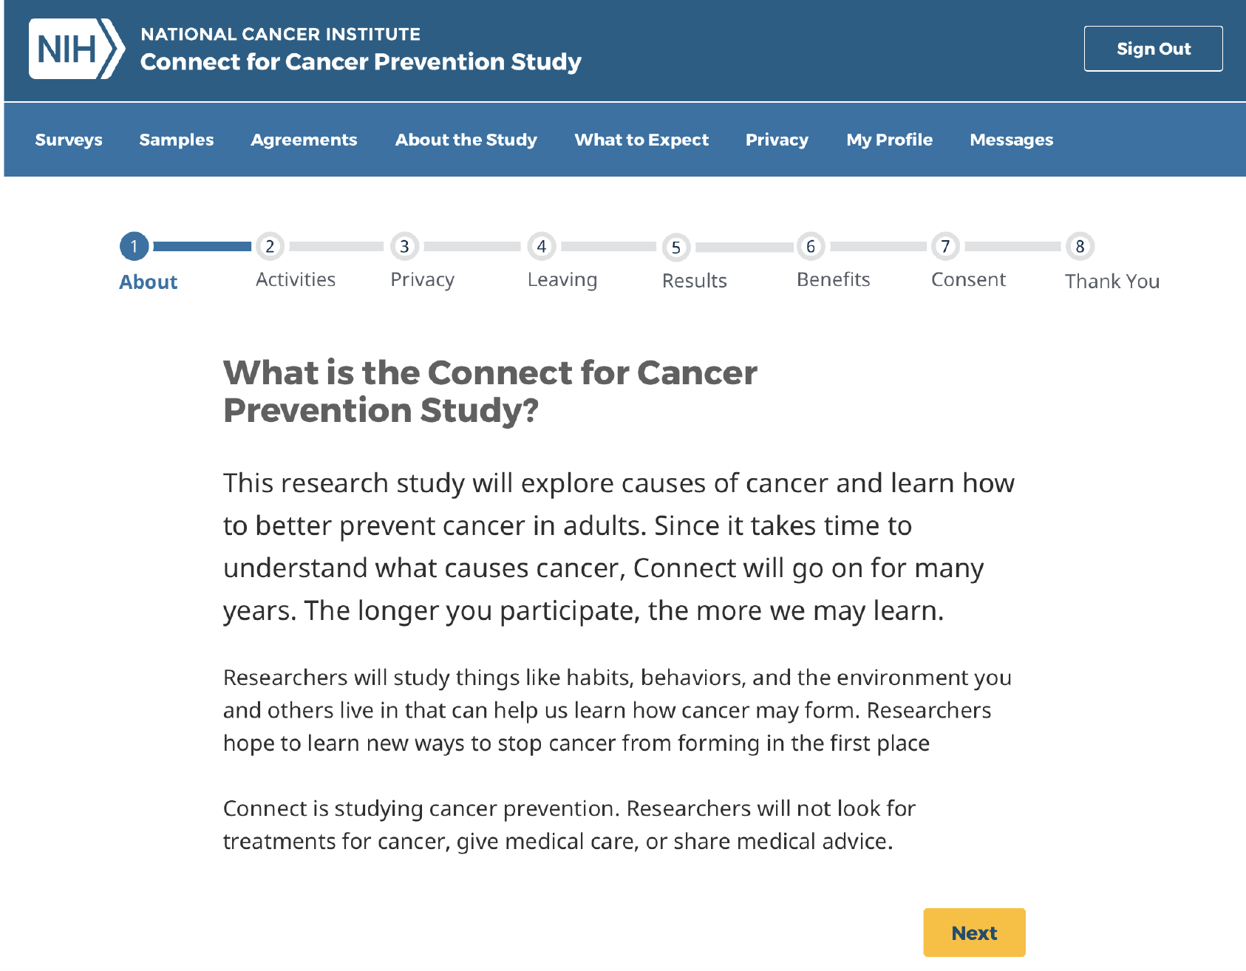
Educational Module before Long Form Consent
Notes:
Electronic consent process on MyConnect- desktop and mobile versions. Potential participants will be guided to click through screens. eConsent screens break down the full informed consent form into digestible pieces of information.
Progress bar, electronic signing, download options available for informed consent and electronic health records release form (HIPAA)

Slide 17
Overview of Study Activities and Data Collection

Slide 18
Study Activities
Timing | Type of Study Activity
 | Participant actively completing… | Occurring in the background…
Recruitment | Surveys | EHR data transfer
 | Specimen donation | Benign breast biopsies, colon adenomas, other tissues
Follow-up | Surveys | EHR data transfer
 | Specimen donation | Clinical archived/ discard specimens
 | Physical measurements | Linkages
 | Wearable devices, downloaded apps | Pathology and radiology imaging
Notes:
Overview of study activities for Connect participants

Slide 19
Biospecimen Collections

Slide 20









Biospecimen Collections at Recruitment
 | No. Tubes | Fraction | Tube Type
Buccal | 1 |  | Saliva-mouthwash kit
Blood | 2 | Serum | 10ml Red top
 | 1 | Plasma/ buffy coat | 10ml Lavender top (EDTA)
 | 1 | Plasma/ buffy coat | 10ml Green top (Heparin)
 | 1 | Whole blood | 6ml ACD
Urine | 1 |  | 10ml Urine kit
Tissue |  |  | Precursor tissue blocks, if available
Clinic
Home
Mailed collection kit
Central Processing & Biorepository
Notes:
As a reminder, we will be collecting blood, urine, and saliva samples at the clinic and in some cases saliva at home at the baseline recruitment collection.

Slide 21
Biospecimen Collections at Follow-up
Timed on average two to three years
More frequent for participants at higher risk of cancer
Series of same biospecimens and new types of biospecimens (e.g., liquid biopsy, stool)
Located at healthcare system, external clinic, home
Paired with questionnaires and other relevant data collection

Slide 22
Surveys

Slide 23
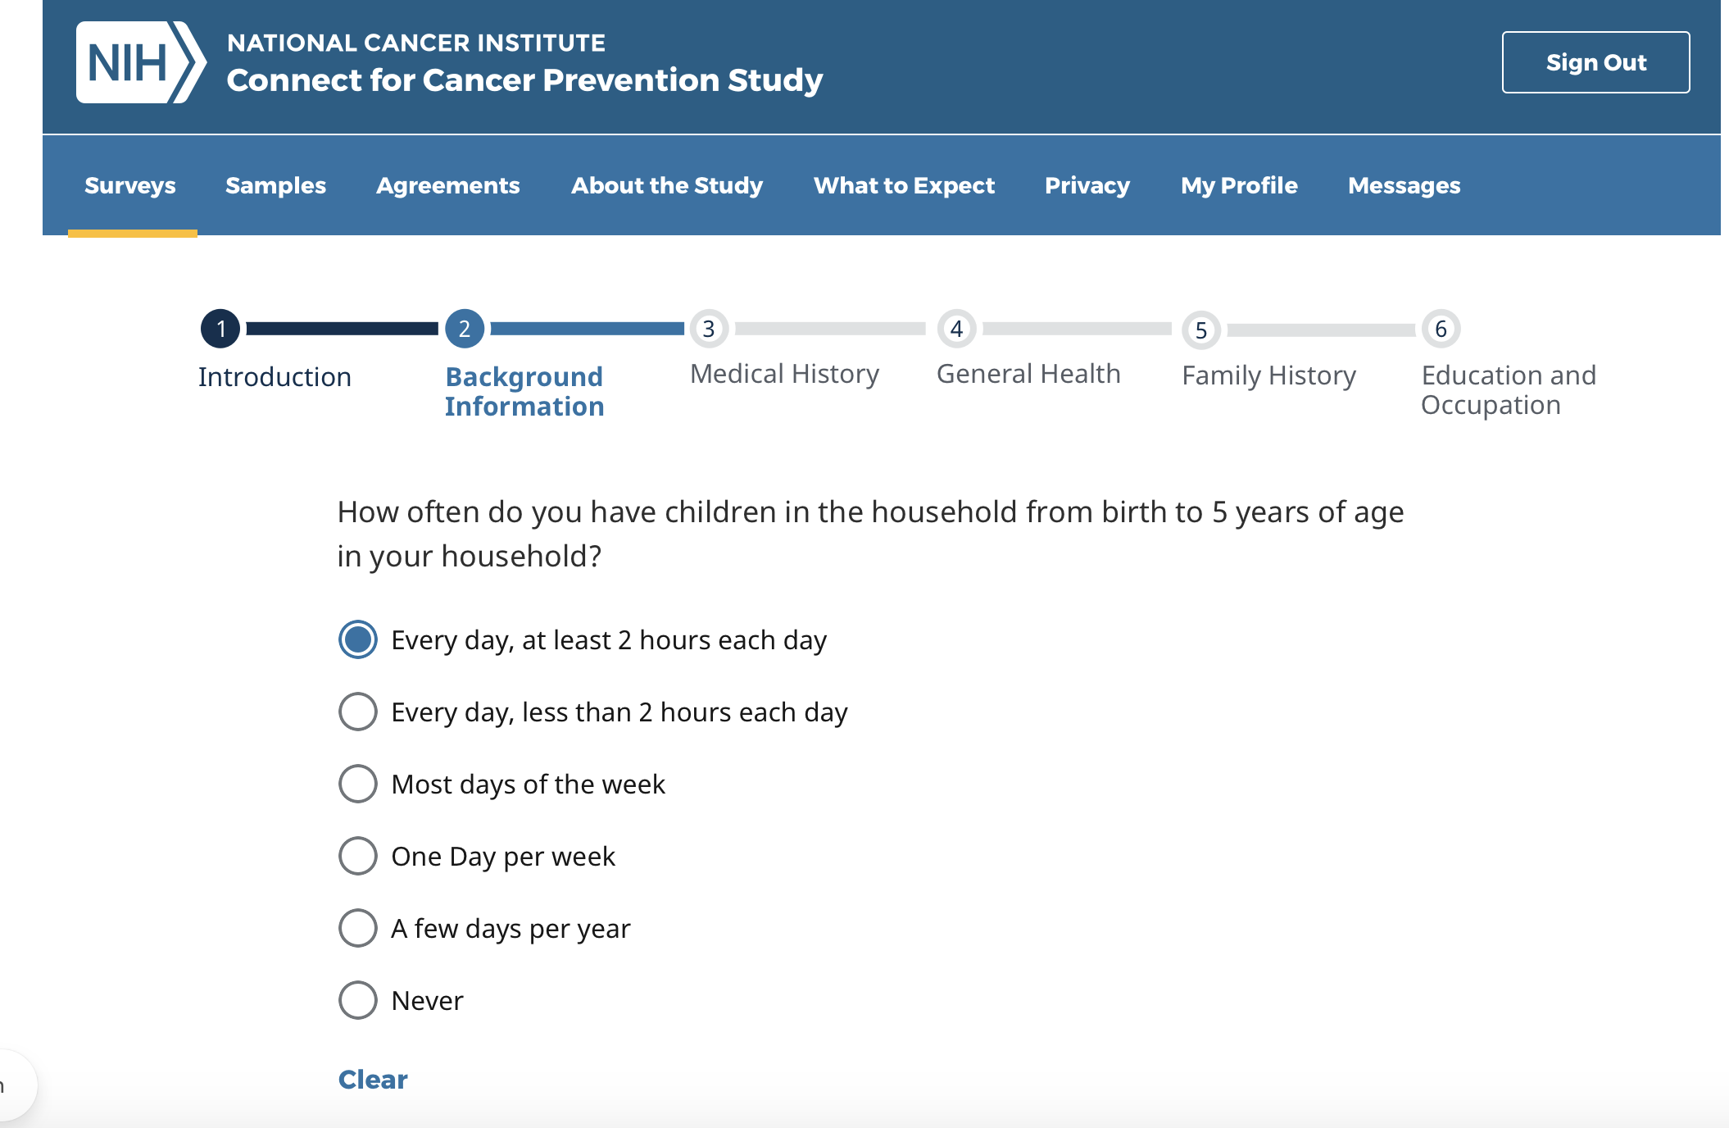
Questionnaire Module Topics and Display in MyConnect at Recruitment
Background and Overall Health
Background Information
Education and Occupation
Medications, Reproductive Health, Exercise, Sleep
Medications
Medical History
Family History of Cancer
Physical Activity
Sleep
Pregnancy History
Smoking, Alcohol, Sun Exposure
Tobacco
Marijuana
Alcohol
Sun Exposure
Where You Live and Work
Residential History
Commuting
Notes:
Initial Survey available on MyConnect- broken into four sections. Time estimate to answer questions in all sections is 1-2 hours. Can start answering, pause, and go back to complete answering at any time. We will be discussing administration of follow up surveys with PAB to determine approaches to encourage completion.
Background and Overall Health: background information, medical history, family history of cancer, general health, education and occupation
Medications, Reproductive Health, Exercise, Sleep: medications, women's reproductive health, physical activity, sleep
Smoking, Alcohol, and Sun Exposure: tobacco, marijuana, alcohol, sun exposure
Where You Live and Work: residential history, commuting

Slide 24
Questionnaire Topics to Accompany Biospecimen Collection at Recruitment
Blood
Covid-19 exposure and vaccination
Urine
Menstrual cycle dates (last, next)
Mouthwash
Oral health and care
Menstrual cycle dates (last, next)
Recent exposures to food, drink, pharmaceuticals
Recent exposures to food, drink, pharmaceuticals
Recent exposures to food, drink, pharmaceuticals
Collection parameters, if home collection

Slide 25
Planned Follow-up Surveys
6 Months
Within 24 Months
12 Months
2 Years
Diet food frequency questionnaire (DHQ)
Repeated 24-hour recalls for diet (ASA24) &
physical activity (ACT24)
Screening
Quality of life
Psychosocial
Update on baseline exposures, additional questions of covered and other topics
Survey 3-6 months after cancer diagnosis
Notes:
Goal is to provide surveys every 6 months to a year with a combination of new content and repeat content to ascertain exposure updates. We also plan to send questionnaires to certain sub-populations, such as cancer patients.

Slide 26
Data Linkages

Slide 27

Data Linkages
Cancer registries, virtual tumor registry
Mortality (NDI)
Geospatial data (such as outdoor air quality data, other EPA MyEnvironment, WATERS data, US Census)
External health care records
(such as Medicare, other EHR for participants that leave IHCS)
Health outcomes data
(such as HIV registry)

Slide 28
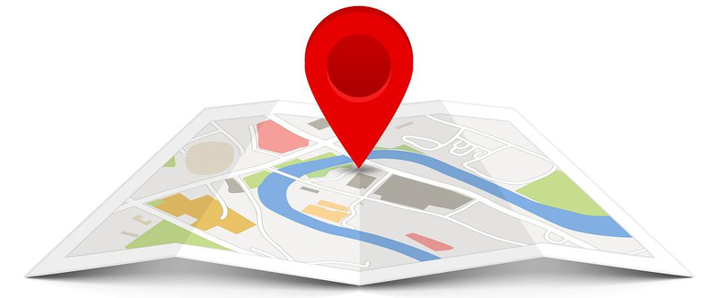
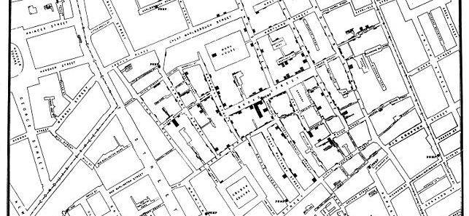
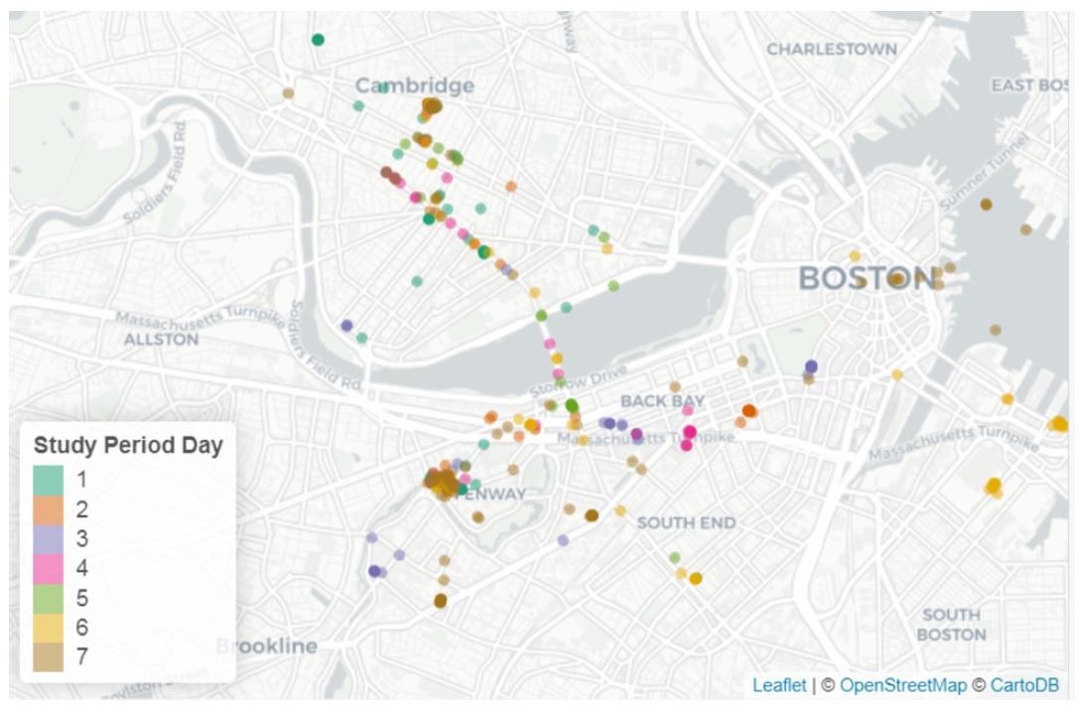
Geographic Information
Geocode 20-year address histories (collected on baseline survey)
Enable linkages to datasets for numerous external risk factor and exposure information
Useful for planning ancillary field studies
Add daily movement and travel to exposure information via MyConnect
Fore et al., 2020
Notes:
Future data collection activities
Geocoding = the process where we try to assign precise latitude longitude coordinates to represent the physical location of an address on a map
All geocoding and linkages are planned to be done in-house

Slide 29

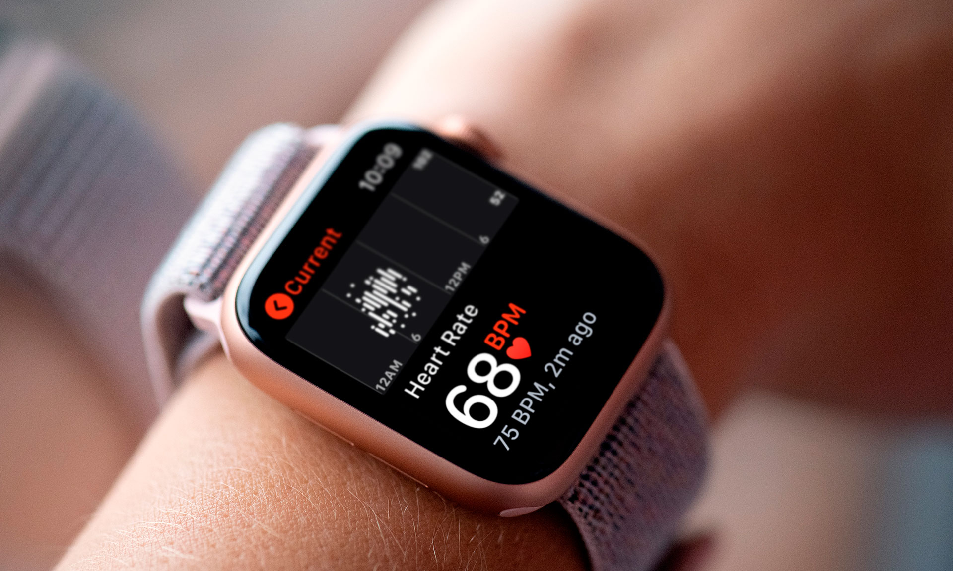
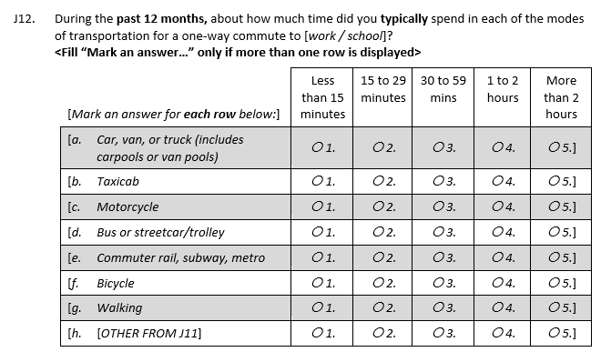
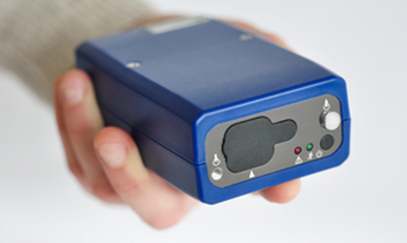
Wearable Devices and Apps
Connect will have research-grade and consumer-oriented devices available
Key domains where tech can improve assessment of exposures and risk factors:
sleep
light at night
air pollution
physical activity

Slide 30
Estimated Outcomes

Slide 31
Estimated total number of incident invasive cancers
Cancer site | Total Number of Expected Incident Cancers
 | 10 years of follow up | 15 years of follow up
Prostate (males only) | 1,951 | 3,595
Breast (females only) | 1,566 | 2,553
Lung & Bronchus | 1,151 | 2,165
Colorectal | 877 | 1,566
Melanoma of the Skin | 410 | 681
Non-Hodgkin Lymphoma | 369 | 649
Uterine Corpus | 345 | 579
Urinary Bladder | 327 | 622
Thyroid | 232 | 356
Pancreas | 221 | 410
Leukemia | 203 | 365
Ovary | 146 | 246

Slide 32
Estimated Total Number of Precursor Lesions
Lesions | Total Number of Expected Precursor Lesions
 | Retrospective at Baseline | Prospective at 10 Years of Follow Up
Colorectal Adenomas | 5,778 | 18,311
Benign Breast Biopsies (females only) | 2,339 | 4,942
Dysplastic Nevus | 2,311 | 3,779
Cervical Biopsies (females only) | 2,137 | 2,822
High-Grade Prostatic Intraepithelial Neoplasia (males only) | 238 | 384
Lung Nodules | 165 | 349

Slide 33
Data System Infrastructure & Digital Tools
Designed to maximize F.A.I.R. principles

Slide 34
F.A.I.R. Data Ecosystem Makes F.A.I.R. Data
Findable
Unique data identifiers and metadata that is searchable using web-based tools
Accessible
Retrievable data by identifiers based on a shared governance model
Interoperable
Data architecture that allows for integration of data from a range of sources and applications
Reusable
Goal of F, A, and I to allow reuse of data, code, and tools
Principles
Implementation
in Connect
Online, searchable data dictionary
Map variables to common thesaurus to aid pooling (planned)
Authentication and authorization parameters to enforce governance
Online governance and instructions for data access (when data available)
Cloud-based data available through governed APIs
Data, metadata, code, tools and infrastructure available through public, versioned, open-source code on GitHub
https://www.go-fair.org/fair-principles/; https://episphere.github.io/
Notes:
Mapping to common thesaurus should be moved to interoperable – this is about data integration/harmonization.
I know you like the slide, but I think it will confuse more than help – it doesn’t completely match the framework we use in the paper. I would move this to another meeting when we have more time to focus on FAIR and what it means in practice for Connect and data integration with other cohorts.

Slide 35
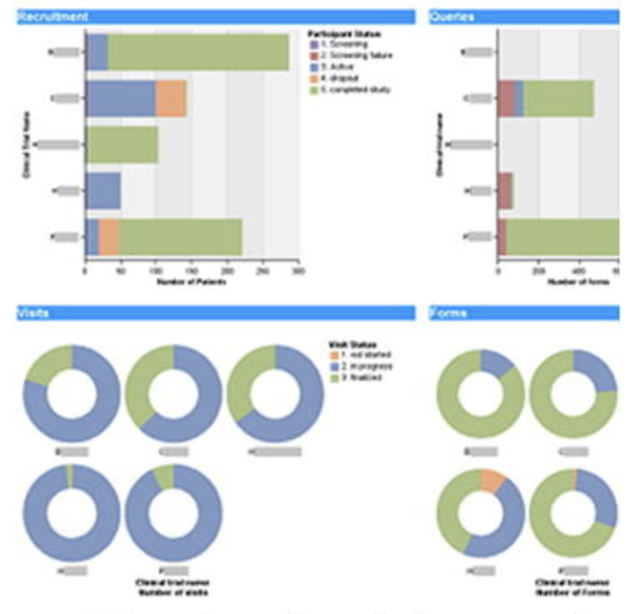
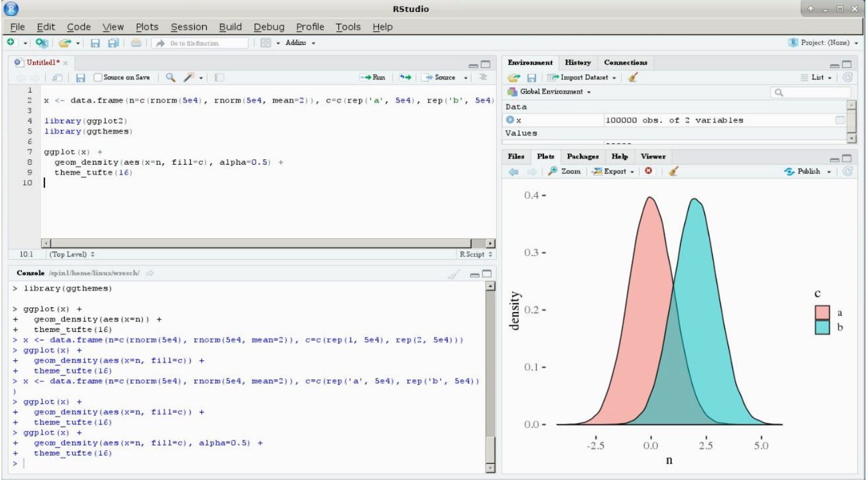

Connect Data Ecosystem provides an interoperable infrastructure
Front-End
User Interfaces
Integration with
other data ecosystems (e.g., wearables) or services (e.g., Twilio)
Apps
Dashboards
Analytics
Middle API Layer
(think phone lines)
Authentication
Authorization
API *
NCI/DCEG
NIH
STRIDES
Back-End
Data Storage
Open-source code available at https://episphere.github.io/
Cloud Storage
Notes:
The Connect data ecosystem has three layers.
Starting at the most visible layers, the front-end interfaces can be created for different user groups. In this diagram, you see the MyConnect participant app, where the participants complete study activities and receive study communications, dashboards for the study staff to monitor recruitment progress, and a dashboard for scientists accessing the epidemiologic data. Access to each interface can be controlled using authentication and authorization protocols.
The middle layer of APIs connects the dashboards/apps to the back end data storage. APIs can also be used to integrate the Connect ecosystem with other data sources (like wearables) and services (like our communication service, Twilio).
The backend data storage uses Google Cloud Platform, a resource available to the NIH community through STRIDES.

Slide 36
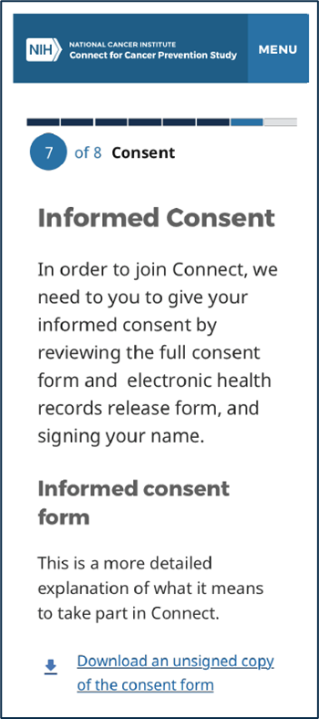
Example of Front-End User Interface: MyConnect Participant App
Study Activity Communication
Informed Consent
Survey Completion
https://github.com/episphere/connectApp
Notes:
There has been a lot of progress in this area since the last update.

Slide 37








Benefit of Middle Layer of APIs: Pulling from multiple resources
Baseline Recruitment
Deidentified data on eligible members/patients
Verification of consented individuals in MyConnect
Study activity flags
Data Linkages
Health outcomes: cancer registries, virtual tumor registry, NDI mortality, HIV registry
Geospatial data: outdoor air quality data, other EPA data, US Census
Study Services
Communications, Twilio
Incentives
Quest survey tool
Participant-Provided Access
Wearable devices: FitBit, air monitors, etc.
External health care records: Medicare, other EHR for participants that leave partner healthcare systems, etc.

Slide 38
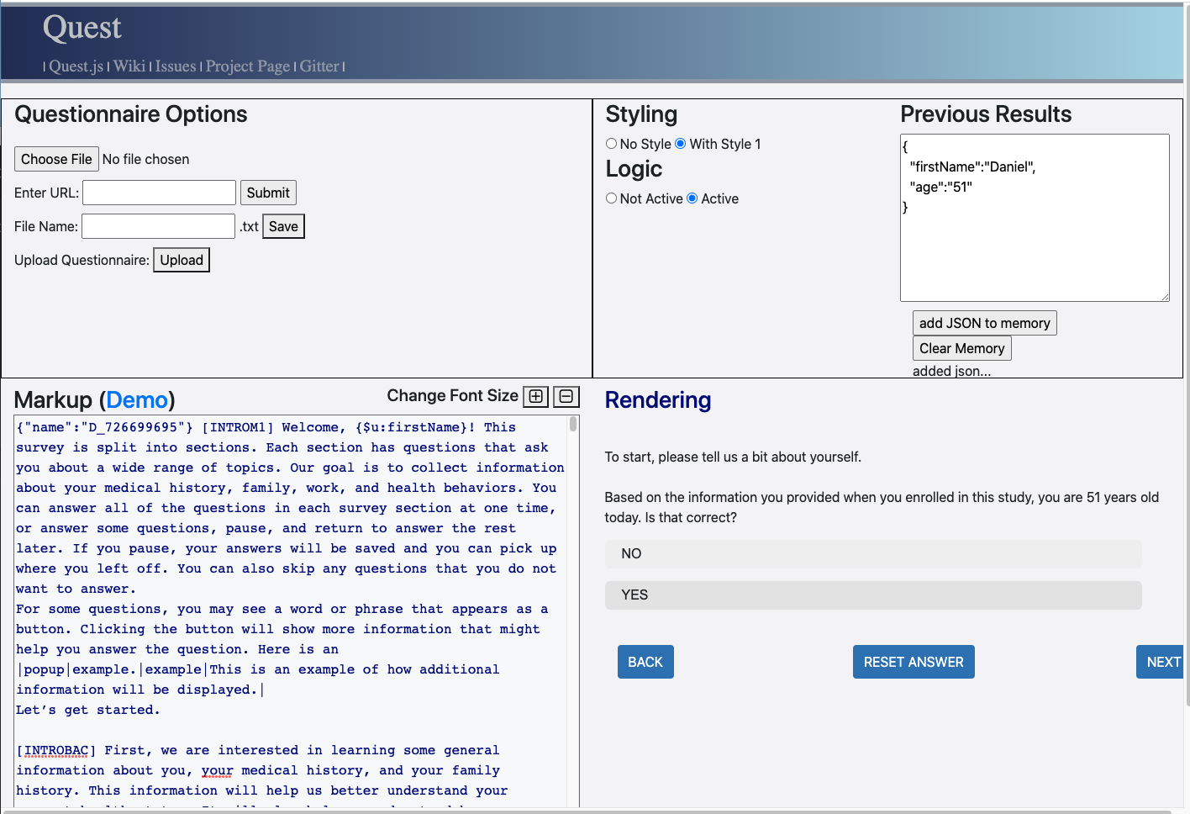
Quest provides open-source code to render surveys into MyConnect and capture data into Connect’s backend data
NCI/DCEG
Open-source code available at https://github.com/episphere/quest

Slide 39
Governance & Organizational Structure
Notes:
Next we would like to review our overall plan for study governance.

Slide 40
Connect Governance
Connect Leadership and Coordinating Center
External Advisory and Review Groups
Governing Board
Stephen Chanock (Chair)
International Scientific Advisory Board
Naomi Allen, Eric Boerwinkle, Julie Buring, Chris Haiman, David Hunter, Roger Milne, Alpa Patel
Executive Leadership
Steering Committee
Chief Scientist (Chair), DCEG Connect PIs, Coordinating Center Leadership, DCEG Associate Directors
Executive Committee
Chief Scientist (co-Chair), Rotating Site PI (co-Chair), Steering Committee Members, Site PIs, Participant Advisory Board Lead,
Support Service Contractor Leads
National Cancer Institute (NCI) Board of Scientific Counselors (BSC) – Clinical Sciences and Epidemiology
Participant Advisory Board (PAB)

Slide 41
Connect Leadership and Organization
Governing Board
Resource Access Committee
Representatives from the Connect Coordinating Center, Executive Committee, external investigators, study participants, ethics experts, and funding agencies
Executive Leadership
Steering Committee
Executive Committee
Ad hoc Expert Review Panels
Subcommittees
Biospecimens ● Questionnaires ● Devices
Meta-Level Data ● Medical Records
Ad hoc Working Groups
EpiSphere Data Science & Engineering Research Group
Jonas Almeida, Chief Data Scientist
Coordinating Center
Mia Gaudet, Chief Scientist of Connect

Slide 42
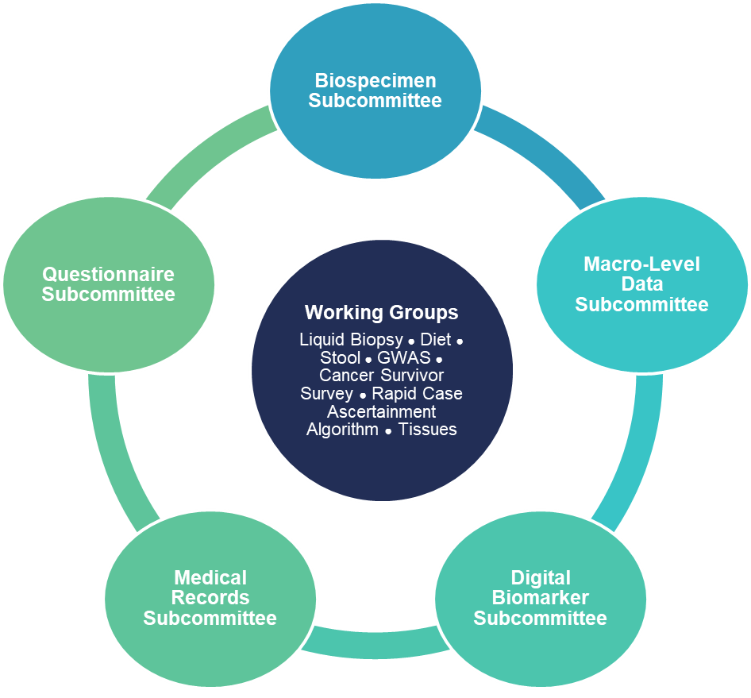
Connect Resource Development Structure
Subcommittees (standing)
Guide development of Connect infrastructure and enhancements
Led by DCEG with NIH investigators
Report to Steering Committee
Working Groups (ad hoc)
Led by nominator with investigators from NIH, recruitment sites, and scientific community
Develop scientific and technical details of proposals and protocols
Report to relevant Subcommittees

Slide 43
Resource Enhancements New questionnaire modules, biospecimens, other sources of data

Slide 44




Connect Resource Building Principles
Research resource enhanced by scientific community
Maximize participant privacy and confidentiality
Balance scientific value with participant burden
All enhancements grow Connect resources

Slide 45
Connect Resource Enhancement Approval Process
Concept
Nominator submits brief summary of enhancement
Proposal
Protocol
Working Group develops protocol in collaboration with Coordinating Center
Implementation
Coordinating Center manages all contact with participants (including reconsent)
Working Group formed, led by Nominator and managed by Coordinating Center
Seek Funding
Form Working Group
Notes:
Uncircle it.

Slide 46
Resource Access Principles

Slide 47
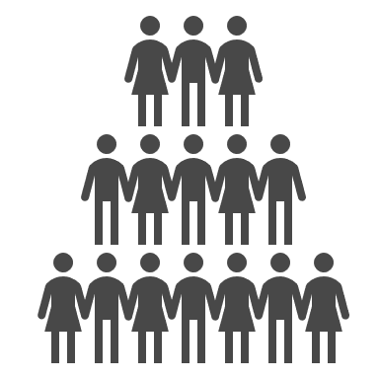

Connect Resource Access Principles
Research resource for scientific community
Participant privacy and confidentiality
Broad data sharing policies
F.A.I.R. data infrastructure

Slide 48
Resource Access for All*
Intramural NCI Investigators
Serial Questionnaires
Extramural NCI/ NIH Grantees
Tumor Registries
Serial
Biospecimens
Connect Resource & Infrastructure
Other NIH Intramural Investigators
International Investigators
Tissue specimens
Electronic Health Records
Imaging
Industrial
Partners
Mobile and wearable technologies
Integrated Health Care System Partners
*Governance procedures forthcoming

Slide 49
Levels of Data Access
Public Access
Univariate distributions and aggregated counts
Controlled Access
Individual-level survey, electronic health record, and derived data
Sensitive Variables
Variables with group or individual stigma or risk for reidentification
PHI Linkages
No shared access to 18 HIPAA identifiers; in-house linkages available to all investigators

Slide 50
Recruitment Timeline

Slide 51
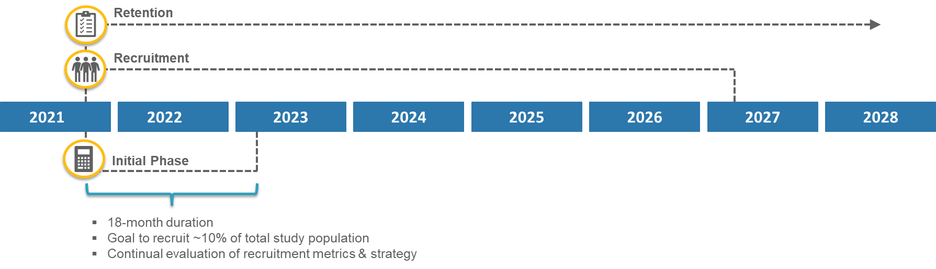
Recruitment Began!

Slide 52
Initial Phase of Recruitment: slow but steady to reach 16,000
Soft Launch

